Slide 1


POWERING
‘
S
GROWTH (2015-21)
By Keval Patel
Keval Patel|LinkedIn
KevalPatel-Analyst (Keval Patel)|GitHub

Slide 2

Powering Netflix’s Growth: What the Data Tells Us (2015–2021)
Stakeholders
Meta Data
Tools Used
Netflix’s Executive or Leadership Team
File Extension - .csv
Power Bi :- For creating dashboard
No of Rows – 8784
Power Query :- For data cleaning and transforming data
Content Strategy Team
No of Fields - 10
Chief Content Officer (CCO)
Canva :- For creating presentation
Data Analytics & Insights Team

Slide 3
Powering Netflix’s Growth: What the Data Tells Us (2015–2021)
Business Problem
Executive Summary
Is Netflix's content library becoming more global over time?
This dashboard presents a deep analysis of Netflix’s content trends between 2015 and 2021. It explores how Netflix is expanding its global footprint, supporting new creators, serving diverse audiences, and shifting genre focus. The insights help leadership assess current strategies and identify new opportunities for global engagement, creative development, and audience alignment.
Which genres are gaining popularity?
Is Netflix focused on new or recycled content?
How balanced is the content distribution across audience age groups?
Are repeat creators still dominating?
How is the content type portfolio balanced?
Which countries are the biggest contributors to the content catalog?

Slide 4
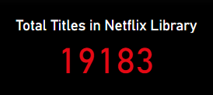


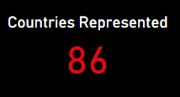
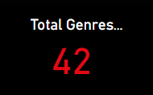
Powering Netflix’s Growth: What the Data Tells Us (2015–2021)
📌 Key Performance Indicators (KPIs)
A clear sign of aggressive growth and catalog expansion.
More people around the world are watching, and they want stories from different countries. Netflix is clearly moving away from just Hollywood content and focusing more on international shows and movies.
US remains dominant in quantity, but new countries are rapidly contributing to the catalog.
Demonstrates a strong effort toward global diversification.
Netflix is offering a wide range of genres to reach both general and specific audiences. This helps users find content they like and makes recommendations more personalized.
Reflects Netflix’s ability to scale content offerings to meet diverse and global demand.
Content is now being sourced from nearly every major continent

Slide 5
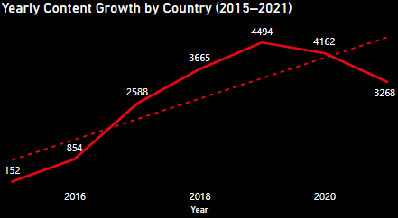
Powering Netflix’s Growth: What the Data Tells Us (2015–2021)
📈 Yearly Content Growth by Country (2015–2021)
Between 2015 and 2020, content count grew exponentially from 152 to over 4,400 titles(2822%).
While the United States still leads, significant growth is visible from countries like India, Pakistan, and Japan.
2021 saw a slight drop of 26% compared to 2020, possibly due to content production delays (due to COVID-19 effects).
📌Insights
Netflix saw explosive global content growth, with a 28x increase from 2015 to 2020. However, the 26% dip in 2021 suggests a slowdown, likely due to pandemic-related production delays. Still, countries like India and South Korea have significantly increased their content contribution, highlighting Netflix’s strategic shift to international markets.

Slide 6
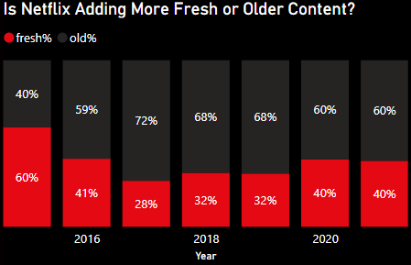
Powering Netflix’s Growth: What the Data Tells Us (2015–2021)
🆕Is Netflix Adding More Fresh or Older Content?
Netflix has gradually shifted from prioritizing fresh/original content to adding a higher proportion of older/licensed content.
The share of fresh content dropped significantly from earlier years and has now stabilized around 40%, indicating a reduced focus on exclusive or newly produced titles.
Older content has consistently increased as a portion of total additions, making up the majority of content in recent years.
This may reflect a cost-optimization strategy, reduced production during certain periods, or a focus on acquiring popular older titles for retention.
📌Insights
After a decline in fresh content from 2015 to 2017, Netflix gradually recovered by 2021, bringing fresh titles back up to 40%, signaling a push toward originals and recent releases.

Slide 7
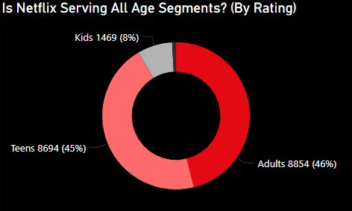
Powering Netflix’s Growth: What the Data Tells Us (2015–2021)
👪 Is Netflix Serving All Age Segments Well?
Majority of content is adult-focused, with high representation of ratings like TV-MA and R.
Kids and family content (TV-Y, G, PG) is significantly underrepresented, indicating a content gap.
Teen content (TV-PG, TV-14) has moderate presence but isn’t leading.
This suggests Netflix’s library is skewed toward mature audiences, with less emphasis on balanced, all-age programming.
Leadership should consider investing in balanced content across all age segments—especially family-friendly or kid-safe content—to expand its user base and improve retention among younger viewers

Slide 8
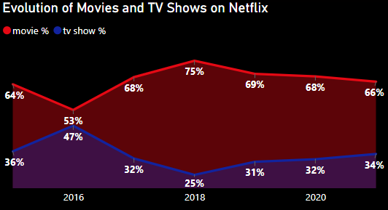
Powering Netflix’s Growth: What the Data Tells Us (2015–2021)
🎬 4. Evolution of Movies vs. TV Shows Over Time
Movies consistently dominate Netflix’s content portfolio, holding over 66% share in recent years.
TV shows saw a decline in share from 47% (2016) to 25% (2018), showing Netflix's shift toward movies during that period
Post-2018, there was a slight recovery in TV show content, increasing to 34% by 2021, but movies still lead significantly.
This trend suggests Netflix’s strategic focus remains on movies, although TV show representation is gradually stabilizing.
📌Insights
To enhance user engagement and increase binge-watching potential, Netflix could explore expanding serialized content (TV shows), especially in high-performing genres.

Slide 9
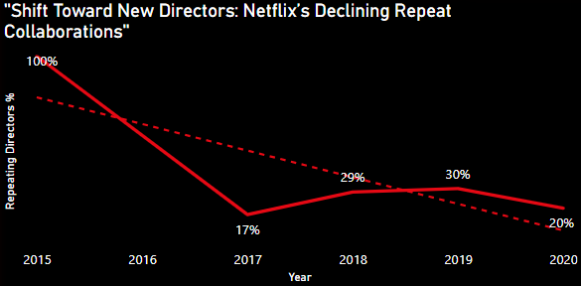
Powering Netflix’s Growth: What the Data Tells Us (2015–2021)
🧑‍🎤 Shift Toward New Directors
From 100% in 2015 to just 20% in 2020, the percentage of repeating directors has dropped significantly.
This trend reflects Netflix’s growing emphasis on diversity, innovation, and fresh creative voices, rather than relying on previously associated directors.
A brief rise from 17% in 2017 to 30% in 2019 indicates short-term flexibility before continuing the downward trend
📌Insights
Netflix has significantly reduced collaborations with repeat directors — from 100% in 2015 to just 20% in 2020. This indicates a clear shift toward bringing in new creative voices, promoting diversity in storytelling and encouraging fresh perspectives. While this opens doors for innovation, leadership should also monitor quality and consistency as newer talent is introduced.

Slide 10
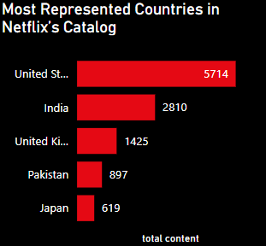
Powering Netflix’s Growth: What the Data Tells Us (2015–2021)
🌍 Top Represented Countries in Netflix’s Catalog
United States dominates Netflix's catalog with 5,714 titles, more than double that of the next country.
India holds the second spot with 2,810 titles, showing Netflix’s strong investment in the Indian market.
United Kingdom comes third with 1,425 titles, followed by Pakistan (897) and Japan (619).
This distribution highlights Netflix's primary focus on Western and Asian markets, while other regions may be underrepresented.
📌Insights
Leadership can use this insight to recognize the need for expanding and investing in content from underrepresented regions to ensure a more diverse and culturally inclusive platform.

Slide 11
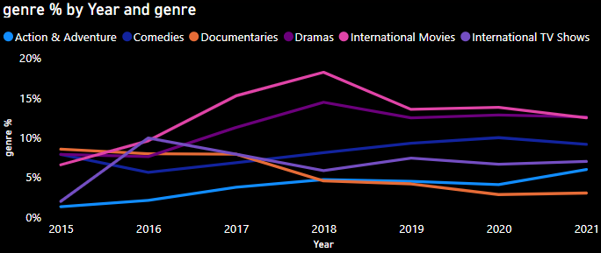
Powering Netflix’s Growth: What the Data Tells Us (2015–2021)
🎭 Genre Trends by Year
International Movies (pink line) and International TV Shows (purple line) have seen the most significant rise, peaking in 2018 with over 18% and 15% respectively. This trend reflects Netflix’s deliberate shift toward a more global and culturally diverse catalog.
Dramas, Comedies, and Documentaries have shown relatively stable or declining shares over time. Notably, Documentaries dropped from around 9% in 2015 to below 4% in 2020, indicating a reduced focus.
Action & Adventure has shown steady growth, although it remains under 10% of total genre share.
📌Insights
The leadership can observe a clear shift in viewer preferences, with rising interest in international movies and action genres, indicating the success of Netflix’s global content strategy. At the same time, the decline in traditional genres like documentaries and comedies suggests the need to reassess investments in these areas to align with evolving audience demand.

